Slide 1
KERNEL OPS
An Operating System Hackathon
TEAM DETAILS
PROBLEM STATEMENT
Team Name: CTRL Freaks
Team Members:
Durga Vaishnavi Ch (Team Leader) - RA2511003011632
K Bhuvana Royal - RA2511003011610
Asleshita Tuduku - RA2511003011633
Theme: I/O management and disk scheduling
PS Number: OSH022
Title: Adaptive Disk Request Scheduler
Generate sequential, random and mixed disk workloads, compare FCFS, SSTF, SCAN and C-SCAN, and build an adaptive policy that shows head movement, waiting time and starvation.

Slide 2
02
Proposed Solution
CORE IDEA
TARGET USERS
KEY FUNCTIONS
A disk I/O scheduler that watches its own request queue and changes policy as the workload changes: nearest request first when the queue is short, an elevator sweep when it is busy, and a rescue for any request that has waited too long.
The operating system's block I/O layer on machines with hard disks: desktops, file servers and databases. Every process that reads or writes the disk gets shorter and fairer waits.
Prototype: an offline browser simulator plus a C++ engine.
• Generates sequential, random and mixed workloads
• Runs FCFS, SSTF, SCAN, C-SCAN, LOOK, C-LOOK on the same requests
• Adaptive policy with a starvation guard
• Shows head movement, waiting time and starvation live
ONE-LINE SOLUTION
One scheduler that adapts to its queue: SSTF's speed without SSTF's starvation.

Slide 3
03
System Architecture
ADAPTIVE I/O SCHEDULER (runs before every dispatch)
Visualizer
browser: disk animation, charts, trace
Monitor
avg queue, clustering, oldest wait
Guard + deadlines
rescue (frozen batch), deadline jump if late
Policy selector
SSTF / LOOK / cluster-SSTF
completion time (feedback)
reads metrics and events
Added after the challenges: deadline override, frozen rescue batch, queue cap
observes
next request
Processes
workload generator: sequential, random, mixed
I/O request queue
pending requests: arrival, cylinder, cap 32 (defer / reject)
Dispatcher
moves the head, serves one request
Disk (simulated)
seek 0.8 ms + 0.0028 ms/cyl, 4.2 ms read
Outputs: head movement, waiting time, fairness and an event trace for every algorithm (FCFS, SSTF, SCAN, C-SCAN, LOOK, C-LOOK, Adaptive). The same engine in C++ produces the benchmark numbers.

Slide 4
04
OS Concepts & Justification
OS CONCEPT 1
OS CONCEPT 2
Disk scheduling (FCFS, SSTF, SCAN, C-SCAN)
Where used: the dispatcher orders requests; Adaptive switches between SSTF and LOOK
Why necessary: seek time dominates disk I/O, so the order decides head movement and waiting time
Starvation and aging
Where used: starvation guard rescues any request waiting over max(80 ms, 4 x typical wait); frozen rescue batch
Why necessary: SSTF can postpone a far request forever; aging puts a bound on every wait
OS CONCEPT 3
OS CONCEPT 4
I/O queue management
Where used: request queue with a cap of 32 (defer or reject) and the monitor
Why necessary: bounded memory under overload; a 3-5 dead band stops the policy flip-flopping
Fairness vs throughput and deadlines
Where used: rescue limit set from measured response time; deadline jump only when a request would be late
Why necessary: a fixed limit fires constantly under heavy load and never under light load; feedback adapts it

Slide 5
05
Implementation Plan & Innovation
PROTOTYPE SCOPE
TECH STACK
INNOVATION
• Workloads: sequential, random, mixed, stress
• 7 schedulers including Adaptive
• Live two-drive disk simulation with sound
• Step view, event trace, challenges C1 to C5
Expected demo: SSTF starving a far request while Adaptive rescues it, side by side.
Language(s): C++17, JavaScript
Framework / UI: HTML5 Canvas and SVG, no framework, runs offline
OS / APIs / Libraries: C++ STL, Web Audio API
Data / simulation tools: event-driven simulator, seeded workloads, CSV results
AI tools: Claude, about 90% of code and documents
Explainable adaptive switching. Before every dispatch it checks starvation, load and clustering, and records why it chose that request.
The rescue limit follows measured response time, and a dead band stops the policy from thrashing.
ALTERNATIVE CONSIDERED
SCOPE / LIMITATIONS
A fixed LOOK policy: simple and starvation-free, but in our tests about 21% slower on average than Adaptive under starvation stress. A C-LOOK mode for heavy load was also tried and dropped: no gain in worst-case wait.
Simulation, not a kernel module: one disk, one head, linear seek cost and a fixed rotation time. Thresholds were tuned on synthetic workloads. Not aimed at SSDs, which have no seek cost.

Slide 6
06
Challenges, Edge Cases & Trade-offs
KEY CHALLENGES
EDGE / FAILURE CASE
MITIGATION / HANDLING
• Starvation: nearest-first choices can leave a far request waiting indefinitely
• Rescue liveness: new arrivals on the rescue path kept extending it
• Overload: 64 requests at once, room for only 32
Correctness (bounded waiting) and performance (waits, memory). Occurs in the starvation guard and the request queue.
Venue challenges C2 and C4: one request waits at cylinder 4900 while new requests keep arriving near the head (1100) and along the path.
Our first rescue served every request on its way, so arrivals stretched it to 21 dispatches and the far request waited 130 ms, no better than SSTF.
Frozen rescue batch (the F-SCAN idea): when a rescue starts, only requests already on its path may go first; new arrivals wait.
The rescue now ends in 2 dispatches and the far request is served at 88 ms. OS mechanism: aging with bounded waiting.
TRADE-OFFS
LIVE CONSTRAINT RESPONSE
Improves worst-case wait: 54% lower than SSTF under starvation stress. Costs some average wait: 37% higher than SSTF there, still 21% better than LOOK.
Fairness vs throughput is set by one parameter, the rescue factor (4 x typical wait by default).
C3 queue cap 32: added admission control (defer or reject) with exact accounting: submitted = served + rejected.
C5 deadlines: a request jumps the queue only if it would otherwise be late; at most 3 jumps in a row while another request starves.
Revised assumption: a rescue that serves everything on its path is not bounded.
6

Slide 7
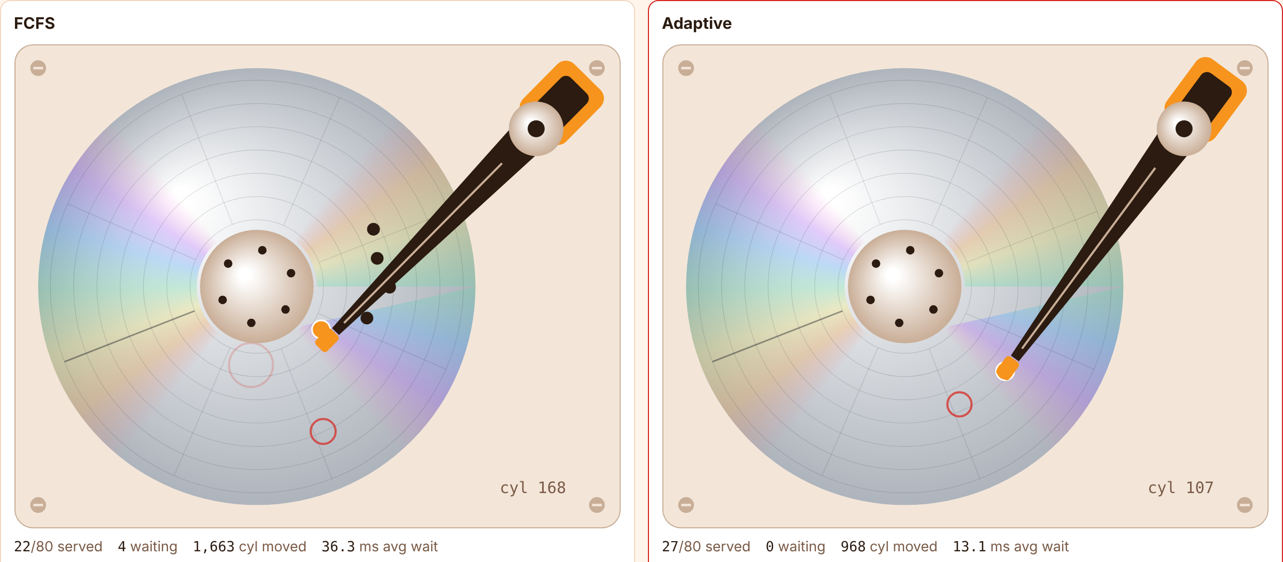
07
Prototype & Demonstration
WHAT WAS IMPLEMENTED
• Seven schedulers: FCFS, SSTF, SCAN, C-SCAN, LOOK, C-LOOK, Adaptive
• Adaptive modes: SSTF, LOOK, cluster-SSTF, rescue sweep, deadline
• Starvation guard with frozen rescue batch (aging, bounded waiting)
• Queue cap with defer / reject admission control
• Live two-drive disk simulation, step view, event trace
• C++ engine for the benchmark; both engines agree on 4,200 test runs
• Conceptual only: running inside a real OS kernel
DEMO SCENARIOS
CHANGES & FUTURE SCOPE
NORMAL CASE: mixed workload on two drives, FCFS vs Adaptive: head movement, waiting time and live decisions.
EDGE / FAILURE CASE: SSTF starving a far request while Adaptive rescues it; venue challenges C1 to C5 as one-click presets with traces.
Changed: frozen rescue batch, queue cap, deadline override, separate C-SCAN direction, event trace.
Future: replay real disk traces, self-tuning thresholds, port to a Linux blk-mq I/O scheduler.
Github Repository Link: github.com/asleshita/Adaptive-Disk
Live demo: asleshita.github.io/Adaptive-Disk
7

